Slide 1
Spotify Music Recommendation System
TSP- AI ML Fundamentals (Capstone Project)
Presented By:
A Sankar Sridhar – au810021214029
Guided By: Ramar Bose Sr. AI Master Trainer

Slide 2
OUTLINE
Problem Statement
Proposed System/Solution
Algorithm & Deployment
GitHub Link
Project Demo(photos / videos)
Conclusion
Future Scope
References

Slide 3
Problem Statement
The Spotify Music Recommendation System aims to provide users with personalized song suggestions based on their musical preferences. Using machine learning techniques and Spotify's vast dataset, the system analyzes song attributes like danceability, energy, and tempo to group songs into clusters with similar characteristics. Users interact with the system by inputting their favorite song and, optionally, specifying a preferred genre. The system then generates tailored lists of recommended tracks that closely align with the user's tastes. Key objectives of the system include accurate recommendation generation, efficient data analysis and preprocessing, user-friendly interaction, and scalability to handle large volumes of data. Moreover, the system strives to continually improve its recommendation capabilities by adapting to changing user preferences and delivering more refined suggestions over time.

Slide 4
Proposed Solution
The solution utilizes the Spotify songs dataset from Kaggle to generate personalized song recommendations. By employing K-Means clustering, the system organizes data points based on attributes like danceability, energy, and tempo, facilitating the identification of songs with similar traits. Users input their favorite songs and optionally specify preferred genres to tailor recommendations. Leveraging the clustering model, the system suggests songs from the same cluster as the user's favorites, ensuring alignment with their musical preferences. Implemented as a standard Python application, the recommender system offers straightforward accessibility. Continuous improvement, driven by user input and performance evaluations, enhances recommendation accuracy, enhancing the overall music discovery experience for Spotify users.

Slide 5
Algorithm & Deployment
• Data Analysis and Processing: Processing and analyzing the Spotify dataset to extract relevant features for recommendation.
• Machine Learning: Implementing the K-Means clustering algorithm for grouping songs into clusters based on their attributes.
• User Interface Design: Designing an interactive interface for users to input their favorite songs and preferred genres.
• Model Deployment: Deploying the recommendation system as a standalone Python application for user accessibility.
• Package Installation: Ensuring the availability and installation of required packages such as pandas, numpy, plotly, yellowbrick for data manipulation, visualizations, clustering respectively.

Slide 6
GitHub Link
https://github.com/sankarsridhar/au810021214029---A-Sankar-Sridhar

Slide 7
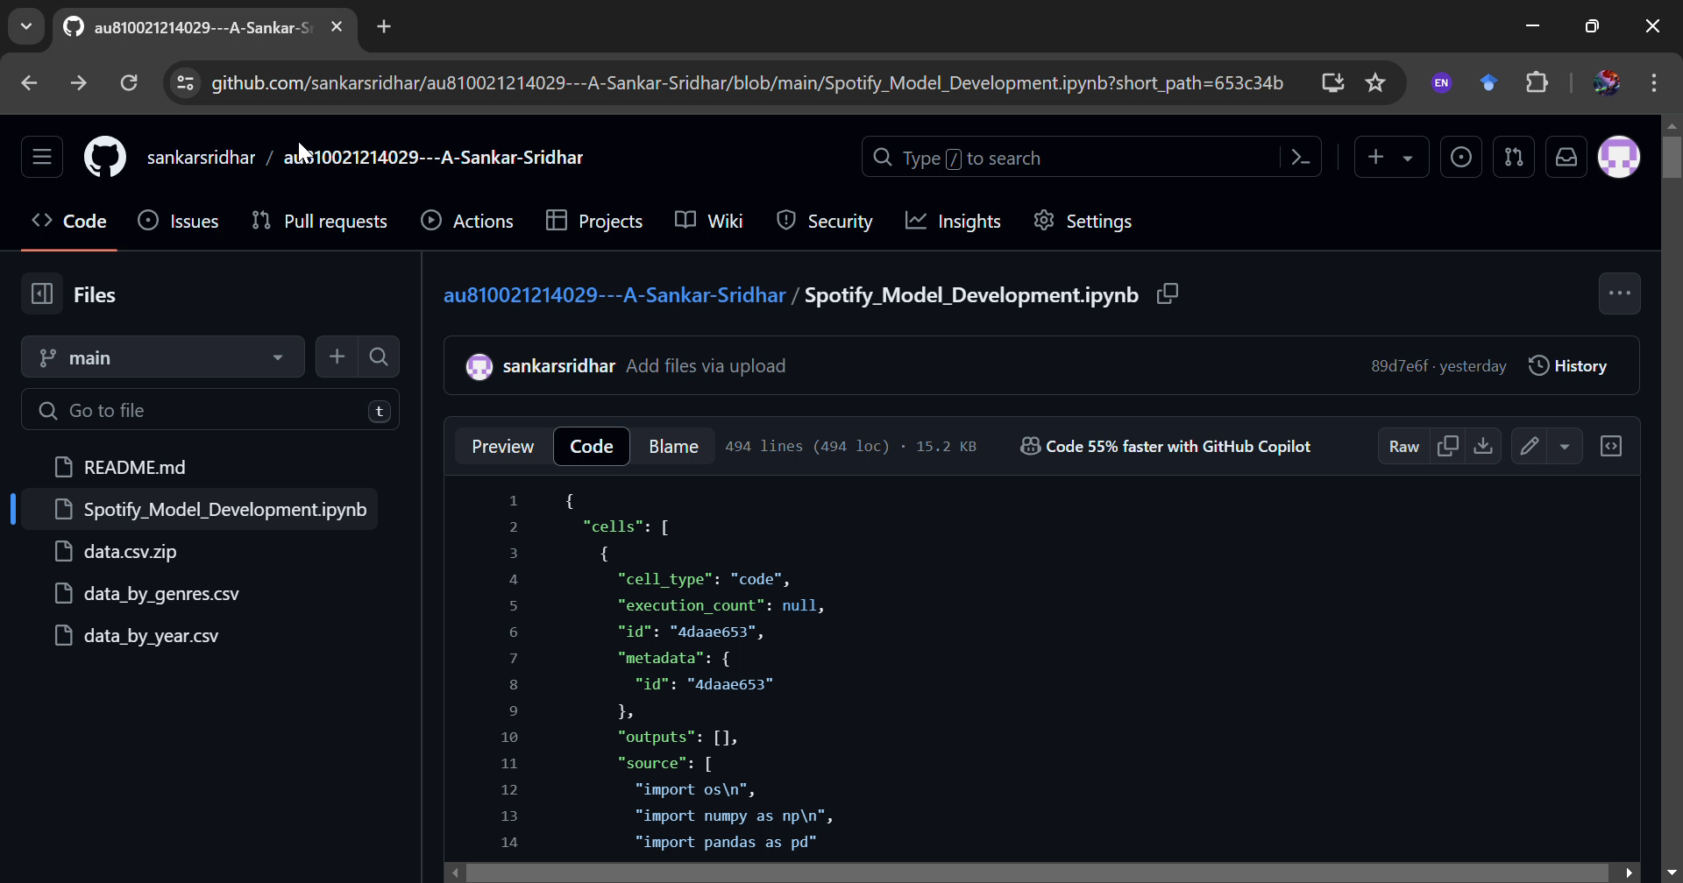
Project Demo(Recorded Video)

Slide 8
Conclusion
The Spotify Music Recommendation App merges advanced machine learning and user-centered design, transforming music exploration for users. Its advanced recommendation engine utilizes methods such as collaborative filtering to analyze user data and deliver customized suggestions, elevating the music listening journey. Its effortless deployment across various platforms and devices has led to widespread usage, fundamentally changing how users discover music within the Spotify ecosystem.

Slide 9
Future Scope
To boost recommendation precision, Spotify's system could explore diverse machine learning methods like matrix factorization and deep learning. Combining these with collaborative filtering and content-based recommendation could capture intricate user preferences better. Enhancing the interface with social features and advanced filtering options would cater to varied user tastes, fostering a more engaging and tailored music discovery journey. Integrating collaborative and content-based filtering methods could further enrich recommendation accuracy by leveraging both user behavior and item attributes.

Slide 10
References
Project Github link, Ramar Bose , 2024
Project video recorded link (youtube/github), Ramar Bose , 2024
Project PPT & Report github link, Ramar Bose , 2024

Slide 11
THANK YOU

